Slide 1
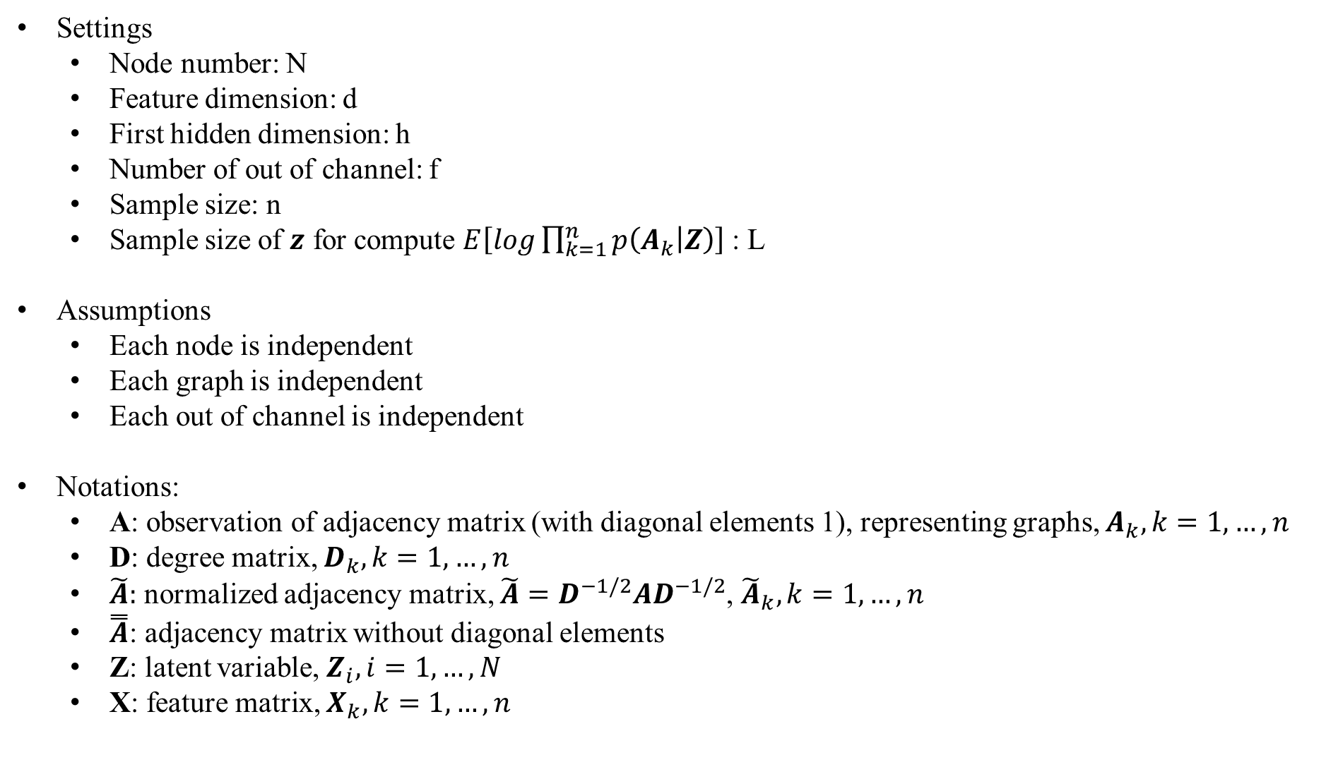
Applied to our setting
Settings
Node number: N
Feature dimension: d
First hidden dimension: h
Number of out of channel: f
Sample size: n
Sample size of $z$ for compute $E\left[log\prod_{k=1}^{n}{p\left(A_{k} | Z\right)}\right]$: L
Assumptions
Each node is independent
Each graph is independent
Each out of channel is independent
Notations:
A: observation of adjacency matrix (with diagonal elements 1), representing graphs, $A_{k}, k=1,…,n$
D: degree matrix, $D_{k}, k=1,…, n$
$\tilde{A}:$ normalized adjacency matrix, $\tilde{A}=D^{−1/2}AD^{−1/2}$, ${\tilde{A}}_{k}, k=1,…,n$
$\overset{̿}{A}$: adjacency matrix without diagonal elements
Z: latent variable, $Z_{i}, i=1,…,N$
X: feature matrix, $X_{k}, k=1,…,n$

Slide 2
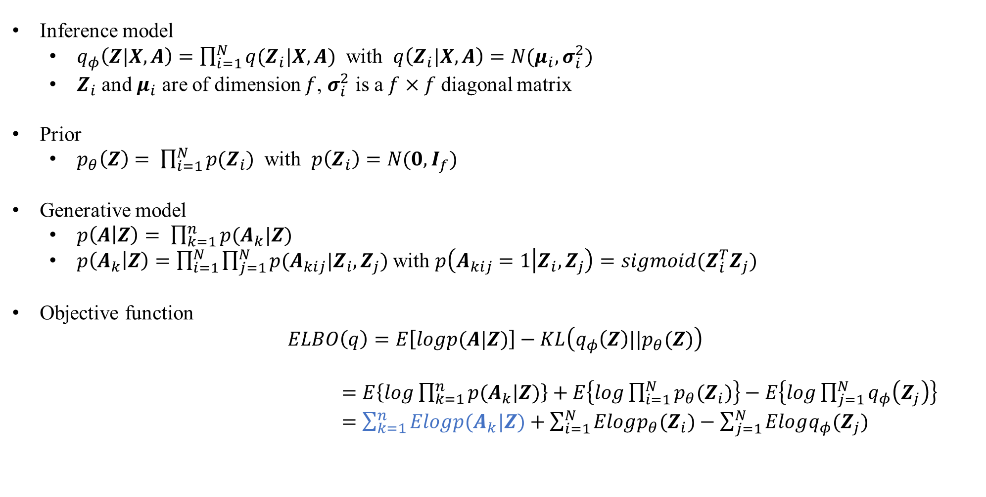
Inference model
$q_{φ}\left(Z|X,A\right)=\prod_{i=1}^{N}{q(Z_{i}|X,A)}$ with $q\left(Z_{i}|X,A\right)=N(μ_{i},σ_{i}^{2})$
$Z_{i}$ and $μ_{i}$ are of dimension $f$, $σ_{i}^{2}$ is a $f×f$ diagonal matrix
Prior
$p_{θ}\left(Z\right)= \prod_{i=1}^{N}{p(Z_{i})}$ with $p\left(Z_{i}\right)=N(0,I_{f})$
Generative model
$p\left(A | Z\right)= \prod_{k=1}^{n}{p(A_{k}|Z)}$
$p\left(A_{k} | Z\right)=\prod_{i=1}^{N}{\prod_{j=1}^{N}{p(A_{kij}|Z_{i},Z_{j})}}$ with $p\left(A_{kij}=1 | Z_{i},Z_{j}\right)=sigmoid(Z_{i}^{T}Z_{j})$
Objective function
$$ELBO\left(q\right)=E\left[logp(A|Z)\right]−KL\left(q_{φ}\left(Z\right)||p_{θ}(Z)\right)$$
$=E\left\{log\prod_{k=1}^{n}{p(A_{k}|Z)}\right\}+E\left\{log\prod_{i=1}^{N}{p_{θ}(Z_{i})}\right\}−E\left\{log\prod_{j=1}^{N}{q_{φ}\left(Z_{j}\right)}\right\}$
$=\sum_{k=1}^{n}{Elogp(A_{k}|Z)}+\sum_{i=1}^{N}{Elogp_{θ}(Z_{i})}−\sum_{j=1}^{N}{Elogq_{φ}(Z_{j})}$

Slide 3
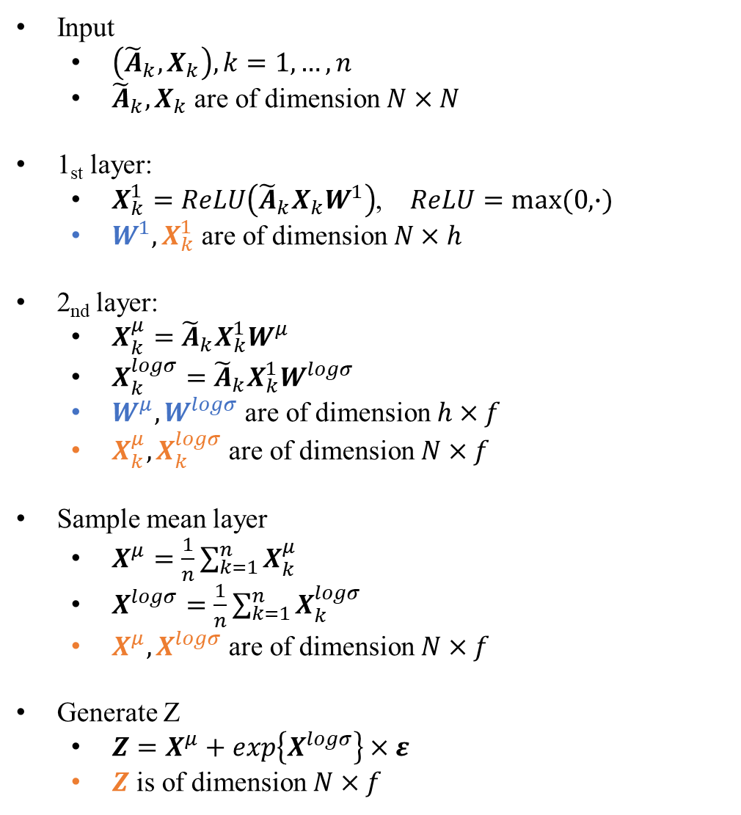
Encoder structure
Input
$\left({\tilde{A}}_{k}, X_{k}\right), k=1,…, n$
${\tilde{A}}_{k}, X_{k}$ are of dimension $N×N$
1_{st} layer:
$X_{k}^{1}=ReLU\left({\tilde{A}}_{k}X_{k}W^{1}\right)$, $ReLU=max⁡(0,∙)$
$W^{1}, X_{k}^{1}$ are of dimension $N×h$
2_{nd} layer:
$X_{k}^{μ}={\tilde{A}}_{k}X_{k}^{1}W^{μ}$
$X_{k}^{logσ}={\tilde{A}}_{k}X_{k}^{1}W^{logσ}$
$W^{μ}, W^{logσ}$ are of dimension $h×f$
$X_{k}^{μ}, X_{k}^{logσ}$ are of dimension $N×f$
Sample mean layer
$X^{μ}=\frac{1}{n}\sum_{k=1}^{n}{X_{k}^{μ}}$
$X^{logσ}=\frac{1}{n}\sum_{k=1}^{n}{X_{k}^{logσ}}$
$X^{μ}, X^{logσ}$ are of dimension $N×f$
Generate Z
$Z=X^{μ}+\exp\left\{X^{logσ}\right\}×ε$
$Z$ is of dimension $N×f$

Slide 4
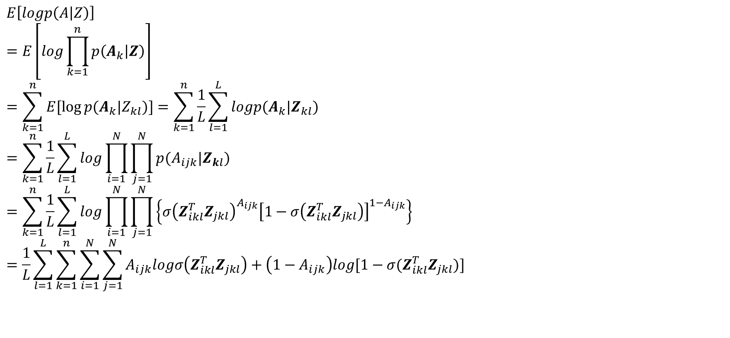

Objective function
$$ELBO\left(q\right)=E\left[logp(A|Z)\right]−KL\left(q\left(Z\right)||p(Z)\right)$$
$$E\left[logp\left(A | Z\right)\right]$$
$$=E\left[log\prod_{k=1}^{n}{p\left(A_{k} | Z\right)}\right]$$
$$=\sum_{k=1}^{n}{E[\log{p(A_{k}|Z_{kl})}]}=\sum_{k=1}^{n}{\frac{1}{L}\sum_{l=1}^{L}{logp(A_{k}|Z_{kl})}}$$
$$=\sum_{k=1}^{n}{\frac{1}{L}\sum_{l=1}^{L}{log\prod_{i=1}^{N}{\prod_{j=1}^{N}{p(A_{ijk}|Z_{kl})}}}}$$
$$=\sum_{k=1}^{n}{\frac{1}{L}\sum_{l=1}^{L}{log\prod_{i=1}^{N}{\prod_{j=1}^{N}{\left\{σ{\left(Z_{ikl}^{T}Z_{jkl}\right)}^{A_{ijk}}{\left[1−σ\left(Z_{ikl}^{T}Z_{jkl}\right)\right]}^{1−A_{ijk}}\right\}}}}}$$
$$=\frac{1}{L}\sum_{l=1}^{L}{\sum_{k=1}^{n}{\sum_{i=1}^{N}{\sum_{j=1}^{N}{A_{ijk}logσ\left(Z_{ikl}^{T}Z_{jkl}\right)+\left(1−A_{ijk}\right)log⁡[1−σ(Z_{ikl}^{T}Z_{jkl})]}}}}$$
(each sample is independent)
(each element of adjacency matrix is independent)
($σ\left(x\right)=\frac{1}{1+e^{−x}}$)

Slide 5
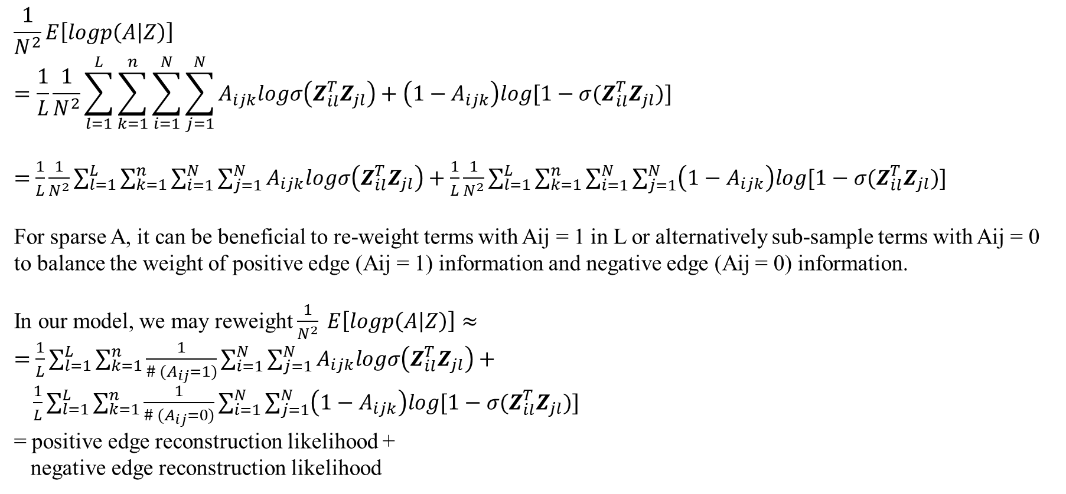
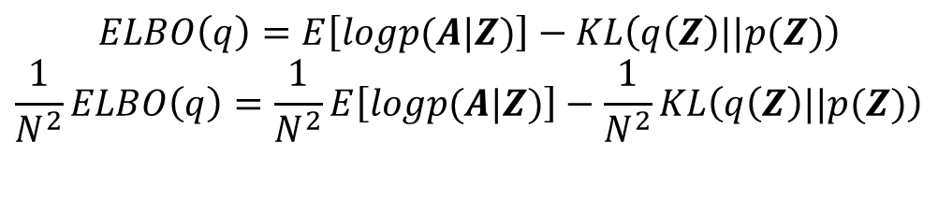
Objective function
$$ELBO\left(q\right)=E\left[logp(A|Z)\right]−KL\left(q\left(Z\right)||p(Z)\right)$$
$$\frac{1}{N^{2}}ELBO\left(q\right)=\frac{1}{N^{2}}E\left[logp(A|Z)\right]−\frac{1}{N^{2}}KL\left(q\left(Z\right)||p(Z)\right)$$
$$\frac{1}{N^{2}}E\left[logp\left(A | Z\right)\right]$$
$$=\frac{1}{L}\frac{1}{N^{2}}\sum_{l=1}^{L}{\sum_{k=1}^{n}{\sum_{i=1}^{N}{\sum_{j=1}^{N}{A_{ijk}logσ\left(Z_{il}^{T}Z_{jl}\right)+\left(1−A_{ijk}\right)log⁡[1−σ(Z_{il}^{T}Z_{jl})]}}}}$$
$=$ $\frac{1}{L}\frac{1}{N^{2}}\sum_{l=1}^{L}{\sum_{k=1}^{n}{\sum_{i=1}^{N}{\sum_{j=1}^{N}{A_{ijk}logσ\left(Z_{il}^{T}Z_{jl}\right)+}}}}$ $\frac{1}{L}\frac{1}{N^{2}}\sum_{l=1}^{L}{\sum_{k=1}^{n}{\sum_{i=1}^{N}{\sum_{j=1}^{N}{\left(1−A_{ijk}\right)log⁡[1−σ(Z_{il}^{T}Z_{jl})]}}}}$
For sparse A, it can be beneficial to re-weight terms with Aij = 1 in L or alternatively sub-sample terms with Aij = 0 to balance the weight of positive edge (Aij = 1) information and negative edge (Aij = 0) information.
In our model, we may reweight $\frac{1}{N^{2}} E\left[logp\left(A | Z\right)\right]≈$
$=$ $\frac{1}{L}\sum_{l=1}^{L}{\sum_{k=1}^{n}{\frac{1}{\# (A_{ij}=1)}\sum_{i=1}^{N}{\sum_{j=1}^{N}{A_{ijk}logσ\left(Z_{il}^{T}Z_{jl}\right)+}}}}$
$\frac{1}{L}\sum_{l=1}^{L}{\sum_{k=1}^{n}{\frac{1}{\# (A_{ij}=0)}\sum_{i=1}^{N}{\sum_{j=1}^{N}{\left(1−A_{ijk}\right)log⁡[1−σ(Z_{il}^{T}Z_{jl})]}}}}$
= positive edge reconstruction likelihood +
negative edge reconstruction likelihood

Slide 6

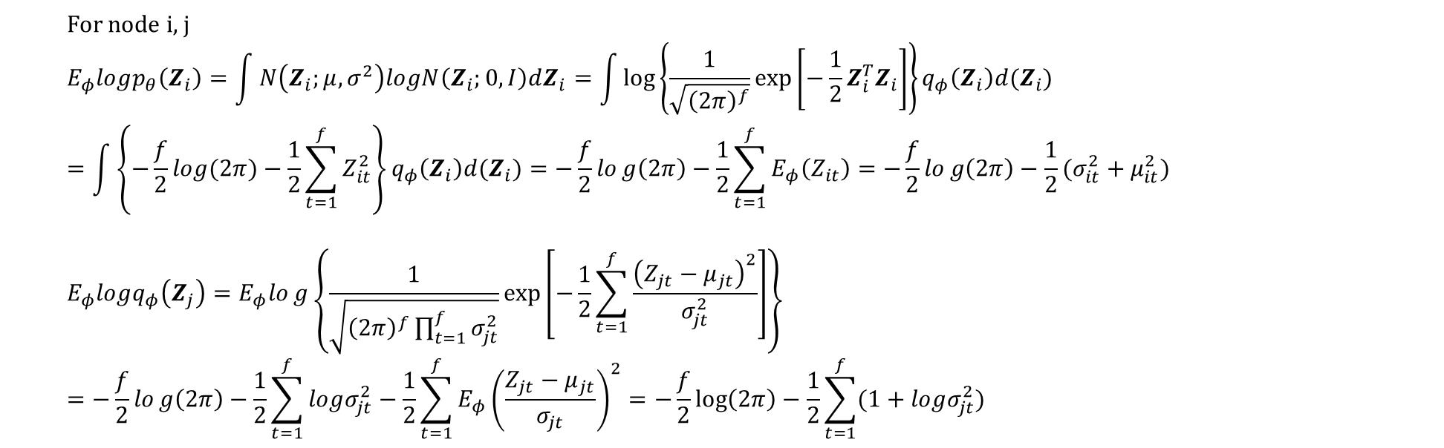
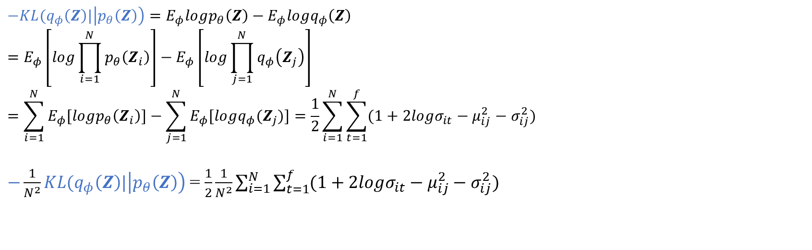
For node i, j
$$E_{φ}logp_{θ}\left(Z_{i}\right)=\int{N\left(Z_{i};μ,σ^{2}\right)logN\left(Z_{i};0,I\right)dZ_{i}}=\int{\log\left\{\frac{1}{\sqrt{{\left(2π\right)}^{f}}}\exp\left[−\frac{1}{2}Z_{i}^{T}Z_{i}\right]\right\}q_{φ}\left(Z_{i}\right)d(Z_{i})}$$
$$=\int{\left\{−\frac{f}{2}log⁡(2π)−\frac{1}{2}\sum_{t=1}^{f}{Z_{it}^{2}}\right\}q_{φ}\left(Z_{i}\right)d(Z_{i})}=−\frac{f}{2}log\left(2π\right)−\frac{1}{2}\sum_{t=1}^{f}{E_{φ}\left(Z_{it}\right)}=−\frac{f}{2}log\left(2π\right)−\frac{1}{2}(σ_{it}^{2}+μ_{it}^{2})$$
$$E_{φ}logq_{φ}\left(Z_{j}\right)=E_{φ}log\left\{\frac{1}{\sqrt{{\left(2π\right)}^{f}\prod_{t=1}^{f}{σ_{jt}^{2}}}}\exp\left[−\frac{1}{2}\sum_{t=1}^{f}{\frac{{\left(Z_{jt}−μ_{jt}\right)}^{2}}{σ_{jt}^{2}}}\right]\right\}$$
$$=−\frac{f}{2}log\left(2π\right)−\frac{1}{2}\sum_{t=1}^{f}{logσ_{jt}^{2}}−\frac{1}{2}\sum_{t=1}^{f}{E_{φ}{\left(\frac{Z_{jt}−μ_{jt}}{σ_{jt}}\right)}^{2}}=−\frac{f}{2}\log\left(2π\right)−\frac{1}{2}\sum_{t=1}^{f}{(1+logσ_{jt}^{2})}$$
$$−KL(q_{φ}\left(Z\right)|\left|p_{θ}\left(Z\right)\right)=E_{φ}logp_{θ}\left(Z\right)−E_{φ}logq_{φ}\left(Z\right)$$
$$=E_{φ}\left[\log{\prod_{i=1}^{N}{p_{θ}\left(Z_{i}\right)}}\right]−E_{φ}\left[\log{\prod_{j=1}^{N}{q_{φ}\left(Z_{j}\right)}}\right]$$
$$=\sum_{i=1}^{N}{E_{φ}[logp_{θ}\left(Z_{i}\right)]}−\sum_{j=1}^{N}{E_{φ}[logq_{φ}(Z_{j})]}=\frac{1}{2}\sum_{i=1}^{N}{\sum_{t=1}^{f}{(1+2logσ_{it}−μ_{ij}^{2}−σ_{ij}^{2})}}$$
$−\frac{1}{N^{2}}KL(q_{φ}\left(Z\right)|\left|p_{θ}\left(Z\right)\right)$ = $\frac{1}{2}\frac{1}{N^{2}}\sum_{i=1}^{N}{\sum_{t=1}^{f}{(1+2logσ_{it}−μ_{ij}^{2}−σ_{ij}^{2})}}$
(each node is independent)

Slide 7
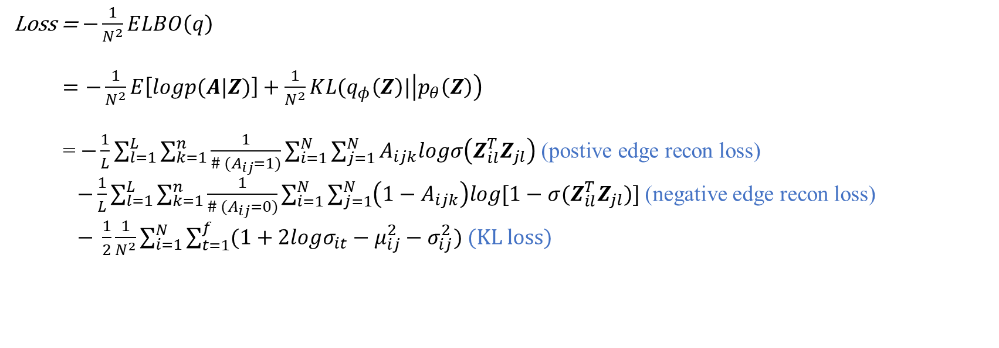
Loss function
Loss = $−\frac{1}{N^{2}}ELBO\left(q\right)$
$=−\frac{1}{N^{2}}E\left[logp(A|Z)\right]+\frac{1}{N^{2}}KL(q_{φ}\left(Z\right)|\left|p_{θ}\left(Z\right)\right)$
= $−\frac{1}{L}\sum_{l=1}^{L}{\sum_{k=1}^{n}{\frac{1}{\# (A_{ij}=1)}\sum_{i=1}^{N}{\sum_{j=1}^{N}{A_{ijk}logσ\left(Z_{il}^{T}Z_{jl}\right) \text{(}\text{postive} \text{edge} \text{recon} \text{loss}\text{)} }}}}$
$−\frac{1}{L}\sum_{l=1}^{L}{\sum_{k=1}^{n}{\frac{1}{\# (A_{ij}=0)}\sum_{i=1}^{N}{\sum_{j=1}^{N}{\left(1−A_{ijk}\right)log⁡[1−σ(Z_{il}^{T}Z_{jl})]}}}}$ (negative edge recon loss) $− \frac{1}{2}\frac{1}{N^{2}}\sum_{i=1}^{N}{\sum_{t=1}^{f}{(1+2logσ_{it}−μ_{ij}^{2}−σ_{ij}^{2})}}$ (KL loss)

